Slide 1
Strongsville City Schools
Athletic Department Funding Presentation to Athletic Boosters
April 12, 2021

Slide 2
Athletic Department Funding Overview
The Athletic Department (Fund 300.0000) is intended to be a self-sufficient department relying on revenues from ticket sales, entry fees, and other contributions to fund the non-personnel expenses related to the athletic activities of the District.
Personnel expenditures such as the salaries and associated fringe benefits for the athletic department and coaches are paid by the District’s general operating budget (General Fund 001).
ORC Section 3315.062(A)
“The board of education of any school district may expense moneys from its general revenue fund for the operation of such student activity programs included in the program of each school district as authorized by it board of education. Such expenditures shall not exceed five-tenths of one percent of the board’s annual operating budget.”
ORC Section 3313.53 (B)
Such board may pay from the public school funds, as other school expenses are paid, the expenses of...directing, supervising, and coaching the pupil-activity programs in athletics.

Slide 3
Strongsville City Schools
Athletic Department Revenues

Slide 4
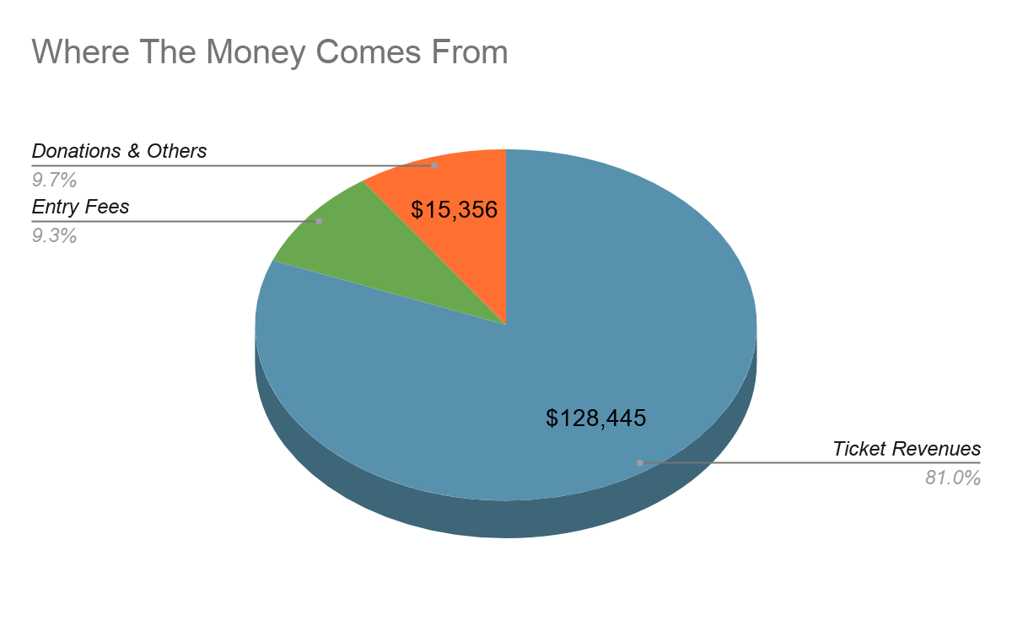
Athletic Department Revenues
Note: Data is for the FY 18-19 school year as it represents the last full school year.

Slide 5
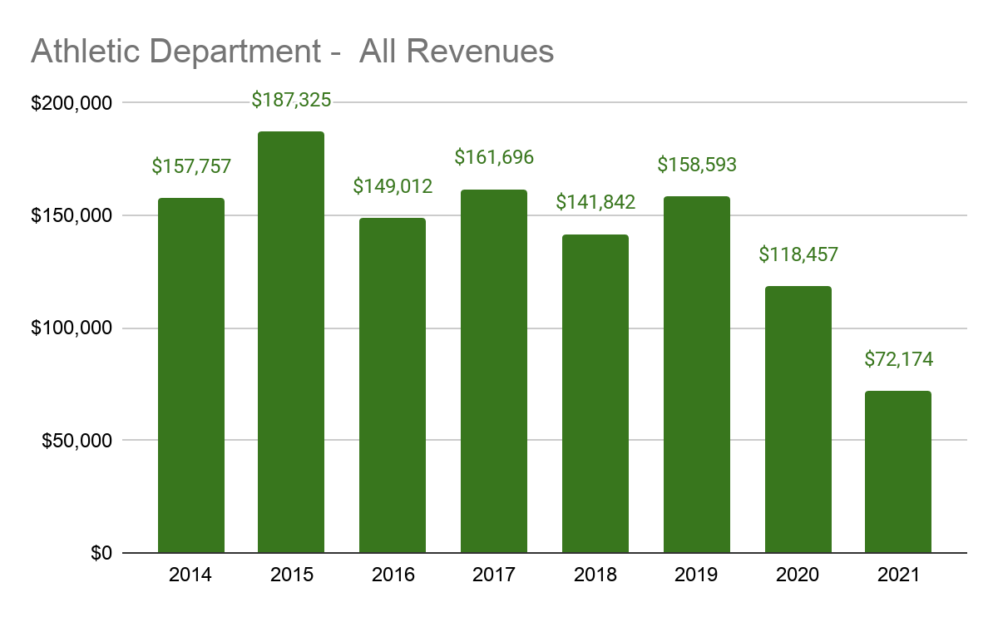
Athletic Department Revenues
All Revenues

Slide 6
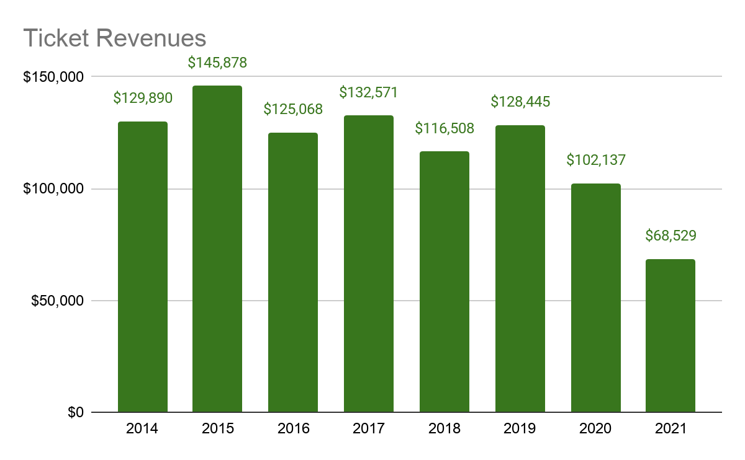
Athletic Department Revenues
Ticket Revenues

Slide 7
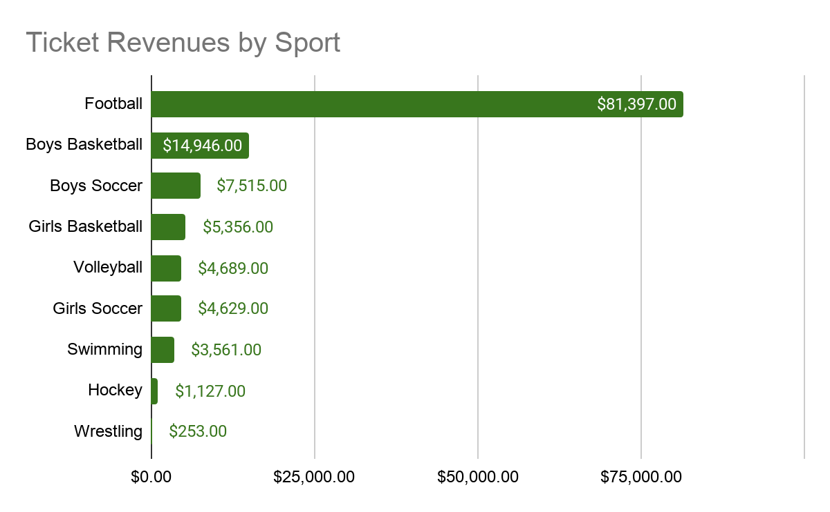
Athletic Department Revenues
Ticket Revenues - By Sport
Note: Data is for the FY 18-19 school year as it represents the last full school year.

Slide 8
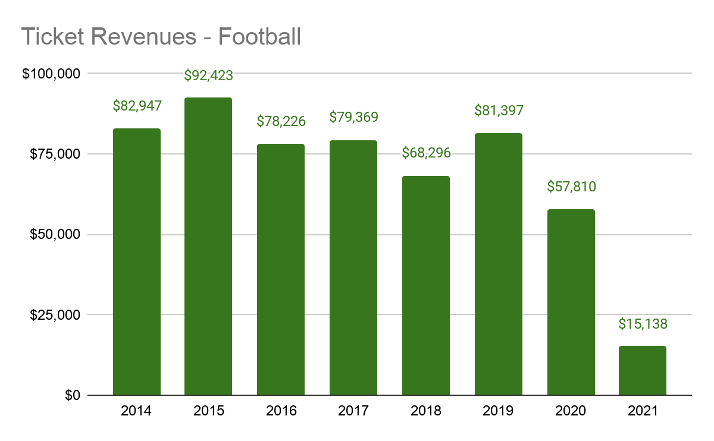
Athletic Department Revenues
Ticket Revenues - Football
Note: Football ticket revenues fluctuate based on home/away schedule and attendance turnout of visiting teams. 2021 was low due to COVID-19.

Slide 9
Strongsville City Schools
Athletic Department Expenditures

Slide 10
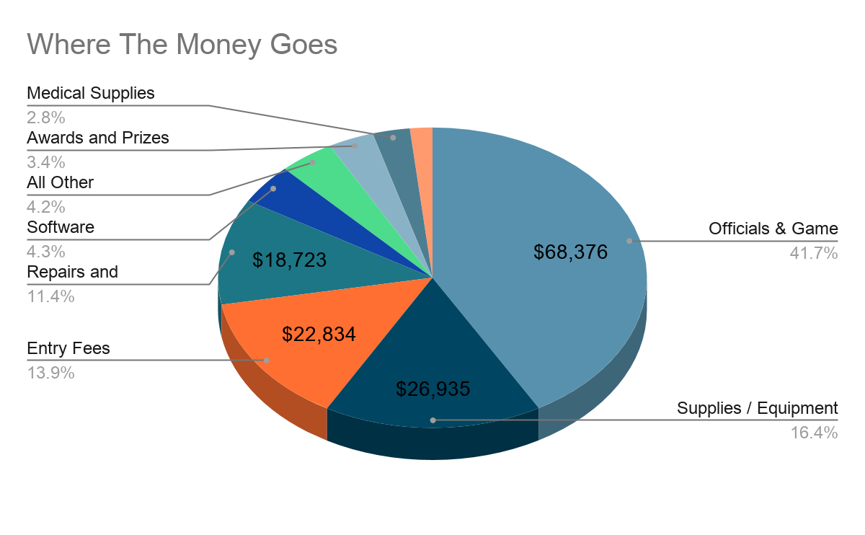
Athletic Department Expenditures
Note: Data is for the FY 18-19 school year as it represents the last full school year.

Slide 11
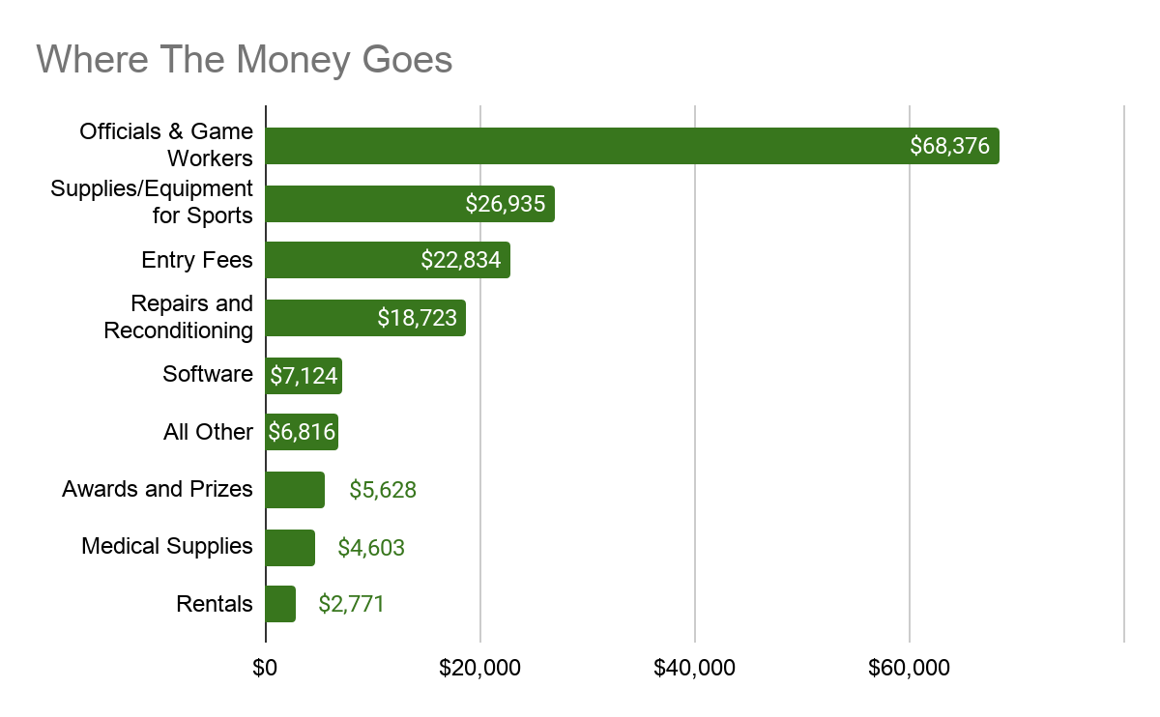
Athletic Department Expenditures
Note: Data is for the FY 18-19 school year as it represents the last full school year.

Slide 12
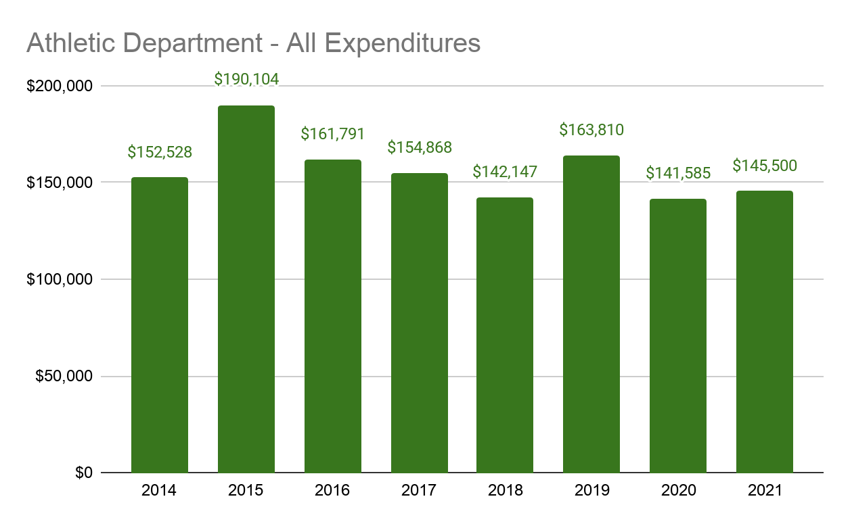
Athletic Department Expenditures

Slide 13
Strongsville City Schools
Athletic Department Summary

Slide 14
Athletic Department Summary
 | 2014 | 2015 | 2016 | 2017 | 2018 | 2019 | 2020 | 2021
Beginning Cash Balance | $72,556 | $77,785 | 75,006 | $62,227 | $69,056 | $68,750 | $63,534 | $40,406
Revenues | $157,757 | $187,325 | $149,012 | $161,696 | $141,842 | $158,593 | $118,457 | $72,174
Expenses | $152,528 | $190,104 | $161,791 | $154,868 | $142,147 | $163,810 | $141,585 | $139,335
Revenues over Expenses | $5,229 | ($2,779) | ($12,778) | $6,828 | ($305) | ($5,216) | ($23,128) | ($67,160)
Ending Cash Balance | $77,785 | $75,006 | $62,228 | $69,056 | $68,750 | $63,534 | $40,406 | ($26,754)
Encumbrances | $0 | $0 | $0 | $4,501 | $7,833 | $1,610 | $8,003 | $6,392
Unencumbered Balance | $77,785 | $75,006 | $62,228 | $64,555 | $60,918 | $61,925 | $32,403 | ($33,146)

Slide 15
Strongsville City Schools
General Fund Extracurricular Expenditures

Slide 16
General Fund Extracurricular Expenditures
Personnel Expenditures:
ORC Section 3313.53 (B)
Such board may pay from the public school funds, as other school expenses are paid, the expenses of...directing, supervising, and coaching the pupil-activity programs in athletics.
Salaries and associated fringe benefits for the athletic department personnel and coaches:
$970,759 - FY 2021

Slide 17
General Fund Extracurricular Expenditures
Non-personnel Expenditures:
ORC Section 3315.062(A)
“The board of education of any school district may expense moneys from its general revenue fund for the operation of such student activity programs included in the program of each school district as authorized by it board of education. Such expenditures shall not exceed five-tenths of one percent of the board’s annual operating budget.” ($390,000 limit)
Non-personnel General Fund expenditures:
Southwest Trainers - $27,000
Ice Rink Hockey Rental - $20,000
Gymnastics Rental - $7,000
Transfer to Athletics due to FY 21 ticket revenue shortfall - $67,160
Music Instrument Replacement - $25,000
Transportation Costs
FY 20 Scoreboards - $136,000 (FY 20 only, reimbursed by Boosters)

Slide 18
General Fund Extracurricular Income
General Fund Extracurricular Income:
Pay to Play - $198,143
Trainer Fee - $16,693
General Fund Extracurricular Income offsets the cost for the coaches and trainer costs.

Slide 19
Strongsville City Schools
Questions?

